Slide 1
SBSC DATABASE PROJECT
Prepared by Team Earth Flutter

Slide 2
Project Objective
Create a SBSC student database system
Project Scope
The database should take in student a. Full Name b. Gender c. Age d. Phone number e. Email Address f. Residential Address g. Bio h. School fees.
This student data will be collected according to the department the student falls under, currently SBSC departments are a. SBSC-Unique b. SBSC-Awesome c. SBSC-Lit
based on the department each student falls into, the departmental name comes before the student data when printing the student info
At the end of the data input process,the sotware should print out all the information submitted as regards that particular student and then ask if the registrar would like to enter a new student information

Slide 3
Methodology
dart:io package was imported
control flow statements were utilized
Class and functions(methods) were created
print() output function was depolyed

Slide 4
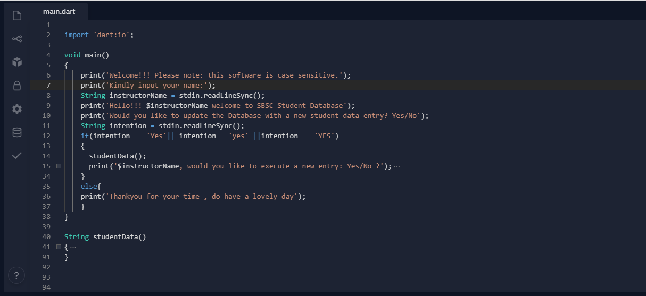
SBSC Student Database Software Syntax

Slide 5
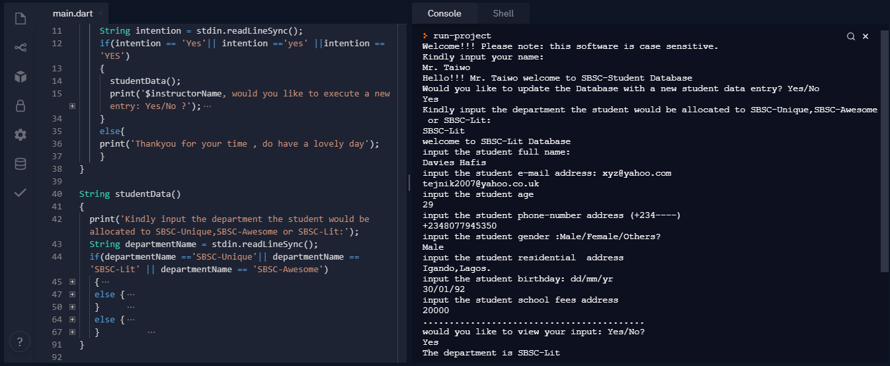
SBSC Student Database Treminal Interface

Slide 6
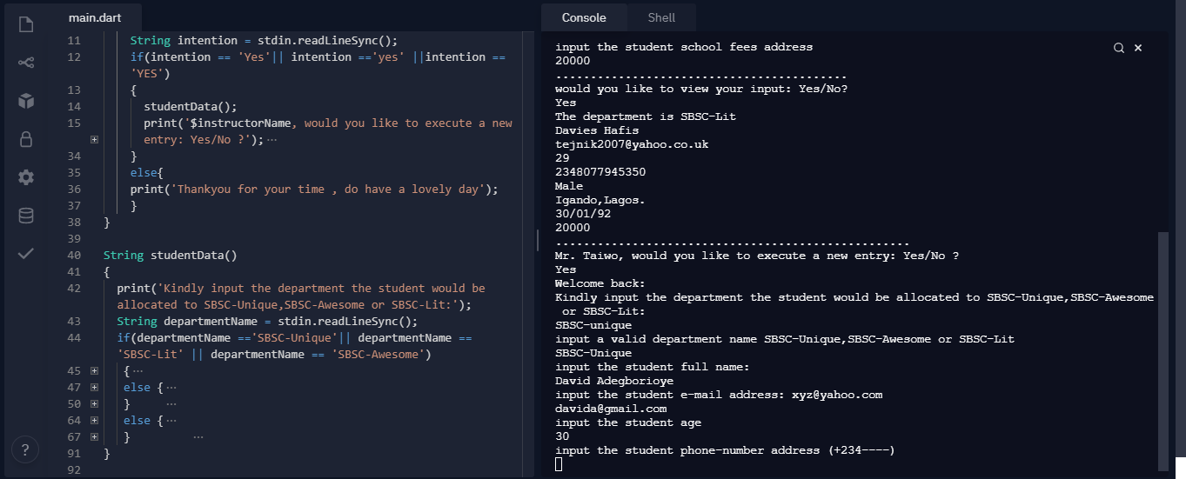
SBSC Student Database Treminal Interface

Slide 7
THANK YOU
Questions?

